Slide 1
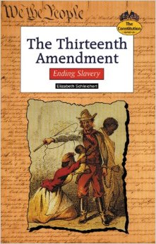
Unjust law:
Involuntary
Servitude.
2016 Lingering Effects of “except as punishment for crime…”
TOPIC
Neo-Slavery?
War Against Mass
Incarceration.
Notes:
“Unjust Law is no law at all.” Our conversation today begins with this wisdom by Augustine of Hippo, a theologian of the Early Church, born in Algeria region on the Africa continent. Then Roman 4:15 picks up the strand: for the Law brings about wrath, but where there is no law, there also is no violation. These are stunning words since, in today’s political area, some appear to be above the law. Does the 13th Amendment reflect ‘unjust law’ by its ‘except as punishment for crime…’

Slide 2
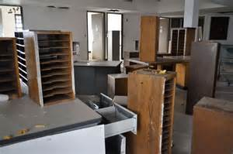
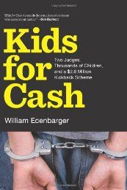
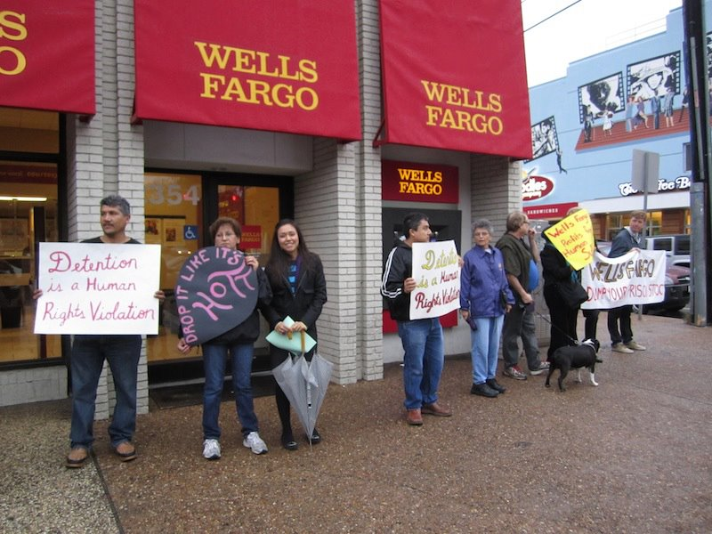
RESOLUTION #D067
2016 PROFITS
Prison-Industrial Complex
Calling on Wells Fargo
to Divest From
For Profit Prisons
Notes:
Has the 13th Amendment language generated the calamity called mass incarceration?

Slide 3
Amending Legal Flaws: The Thirteenth Amendment and
Mass Incarceration
Merelyn B. Bates-Mims, PhD, Presenter
The Organization on Procedural Justice(OPJ)
Diocese of Southern Ohio and The Episcopal Church USA
June 3-4, 2016 BUSINESS MEETING
The University of the District of Columbia
David A. Clarke School of Law
All rights reserved
Fair Use Title U.S.C. Section 107
Notes:
Welcome! To this discussion on Amending Legal Flaws: The Thirteenth Amendment and
Mass Incarceration. The topic of today’s workshop focuses on the carceral policy aspect of the 13th Amendment purported to have abolished slavery in the United States. Except. Except… Except it did not. Slavery has long continued past the December 6, 1865 ratification date, the effects of its disparate impact as a powerful carceral policy growing in intensity over the 150 years of its enactment---so that today, the United States has skyrocketed to number 1 position in incarcerating its people.

Slide 4
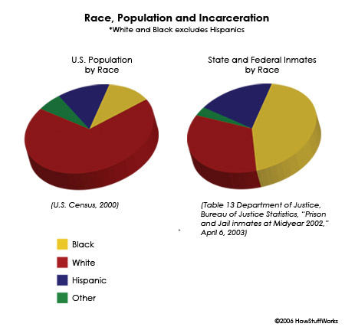
“except as punishment for crime…”
From Private to Public Slave Owners
RESOLUTION #C019
Systemic Racial Injustice
U.S. Census 2000; Department of Justice, Bureau of Justice Statistics. “Prison and Jail inmates at Midyear 2002.” – April 6, 2003
Notes:
In what fashion does the 13th Amendment redefine slavery and re-create systemic racial injustice? By converting slavery by private owners to slavery by public owners. It re-established slavery by public owners.

Slide 5
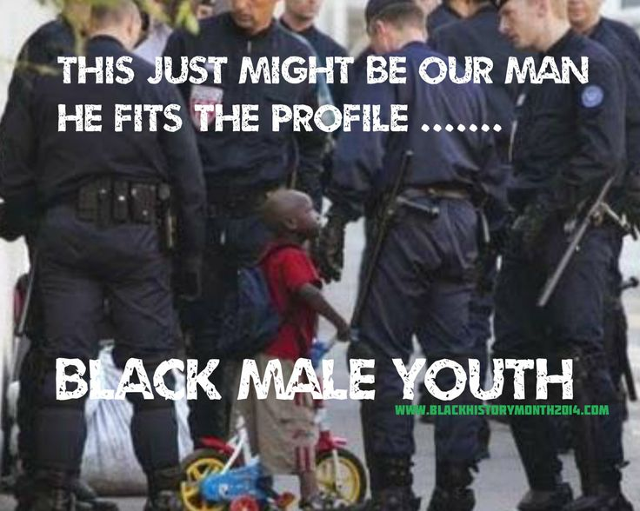
The better way to reduce violence is to ensure that both police and civilians are held accountable when they resort to it.
Notes:
What is procedural justice? Is it observable? Does procedural justice compose and comprise Common Good? What carceral policy underlies this scene? Who is highly likely to be included in the ‘safe’ category of American ethnic groups? Who is less likely to be excluded? Does this scene provide the language of inclusion?

Slide 6
Procedural Justice
Justice implies a behavior or treatment: a concern for peace, and genuine respect for people.
Synonyms:
fairness - justness - fair play - equity - evenhandedness impartiality - objectivity - neutrality - disinterestedness honesty - righteousness - moral - morality
Procedural justice is the idea of fairness in the processes that resolve disputes and allocate resources.
One aspect of procedural justice is related to discussions of the administration of justice and legal proceedings.
Notes:
Justice implies a behavior or treatment: a concern for peace, and genuine respect for people.
Procedural justice is the idea of fairness in the processes that resolve disputes and allocate resources

Slide 7
Prison Slavery
“…for the laborer deserves his wages.” –Luke10:4
A slave is one who, before the 13th Amendment, was legally and forcibly compelled to unpaid labor to the benefit of a private owner, but in this age of the New Jim Crow, as a slave of the State.
Historically, the chattel slave tended to be involved in large-scale industrial and agricultural work—now the 21st century prison industrial complex (CPI).
Notes:
As research shows, slavery as chattel bought and sold, held by private owners, was abolished by the language of the 13th Amendment to the Constitution.

Slide 8
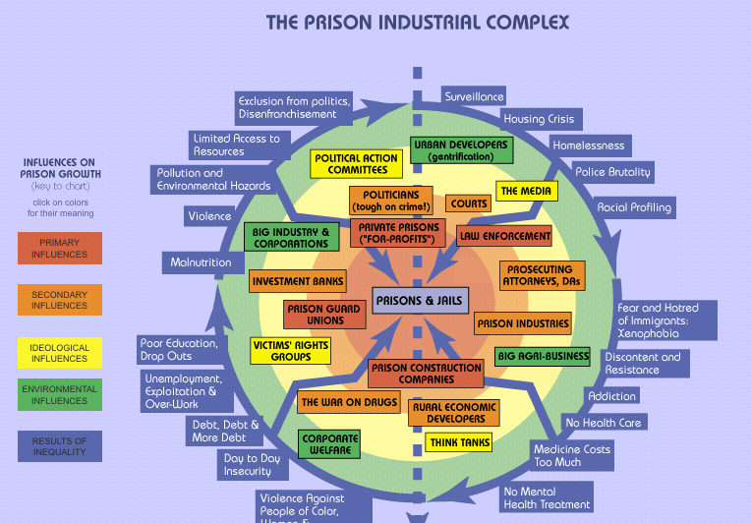
Notes:
This illustration, showing on the screen, gives in one comprehensive glance the scope and content of what is widely called The Prison Industrial Complex. At the center, you can see that all roads to one destination: Prison. Called Jails and Detention centers by other names. Within the green inner circle are phenomena that can be considered the ‘big boys’ of the industry: Corporate welfare; Big industry and corporations; Urban Developers; Big Agri-Business. Bordering the inner circle are the primary influences driving the growth of the system: Private Prisons for-profit; Law enforcement; Prison Guard Unions; Prison Construction Companies; the secondary influences sustaining the complex including Politicians (tough on crime); Courts; Investment Banks; Prosecuting Attorneys and DA’s; and all the adverse outlying Results of Inequality: Exclusion; Surveillance; Homelessness; Racial Profiling and all the malaises of society heaped upon the poor and people of color. This schema is among your handouts so that you may study it yourself.

Slide 9
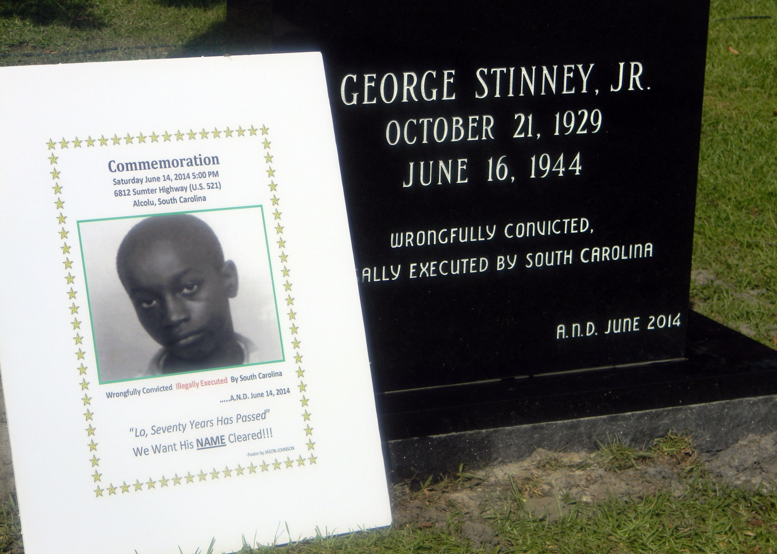
“
Changing the history of “procedural justice”…
Children as young as 8 years old have been tried as adults. -Equal Justice Initiative
Electrocuted under color of law in year 1944 at age 14 and weighing 90 lbs, this child was acquitted in 2014 of murder 70 years later.
thewestsidestory.net
Notes:
Who is entitled to PROCEDURAL JUSTICE? To legal representation? The child, George Stinney, Jr. was electrocuted under color of law in year 1944 at age 14 and weighing 90 lbs, this child was acquitted in 2014 of murder 70 years later.

Slide 10
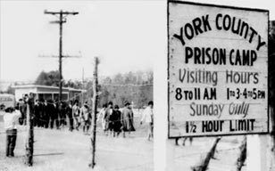
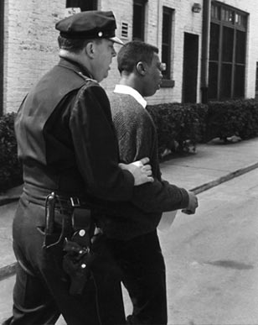
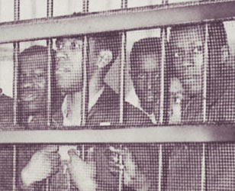
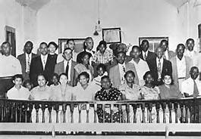
FRIENDSHIP COLLEGE STUDENTS
January 1961 McCrory’s Lunch Counter
Rockhill, South Carolina
United States – Acquitted January 2015
Jail No Bail
Changing History
http://www.friendshipcollege.org/jailnobail.html
Notes:
The top priority of The Episcopal Church is expressed in General Convention RESOLUTION #C019 on Systemic Racial Injustice. What response will the work of The Organization on Procedural create?

Slide 11
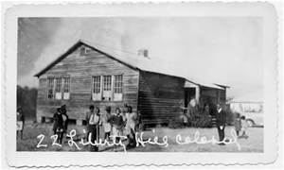
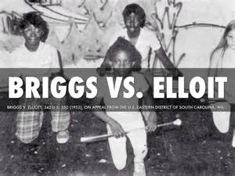
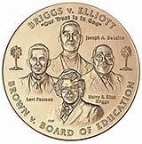
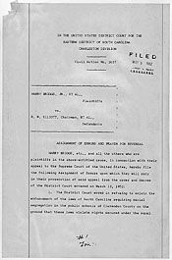
Changing History
Notes:
Is it possible to effect systemic change? To repeal unjust law? To enact justice?

Slide 12
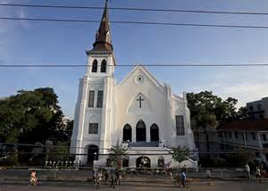
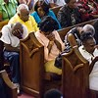
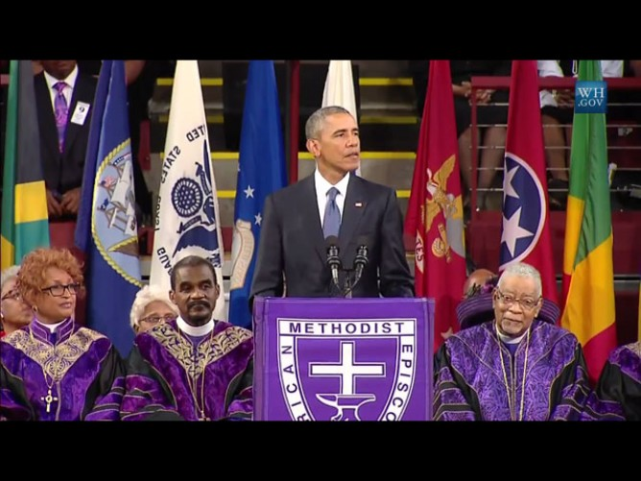
Emanuel African Methodist Episcopal Church – Charleston SC
Changing History
RESOLUTIONS #C019; #C005
Notes:
The Episcopal Church RESOLUTION #C005 ON GUN VIOLENCE AND RESOLUTION C019 looks to Emanuel African Methodist Episcopal Church shootings as work for equality in a new era of RACIAL INJUSTICE HISTORY.

Slide 13

School to Prison Pipelines
RESOLUTION #D068
Notes:
Prison-like environments in schools. The “duly convicted” the language of the 13th Amendment means that persons accused of crime must be brought before a judge. Judges have sentenced children to extended stays in juvenile detention for offenses as minimal as mocking a school principal on MySpace, trespassing in a vacant building, and shoplifting DVDs from Wal-mart, says a February 24, 2009 CNN article titled “Pennsylvania rocked by 'jailing kids for cash' scandal.” Two judges sentencing over 5,000 children secretly received more than $2.6 million in prison industry kickbacks. The system increases the number of inmates in privately-owned for-profit detention centers. Moreover, sentencing kids award monetary kickbacks to some judges in return for imposing harsh sentences on juveniles brought before their courts. Minors charged with nonviolent crimes were often given harsher sentences than what probation officers recommended, court documents say. Other investigators say the trials lasted a few minutes at most. Few kids have legal representation. There are no school-based legal offices although there are school-based arrests by police stationed in schools.

Slide 14
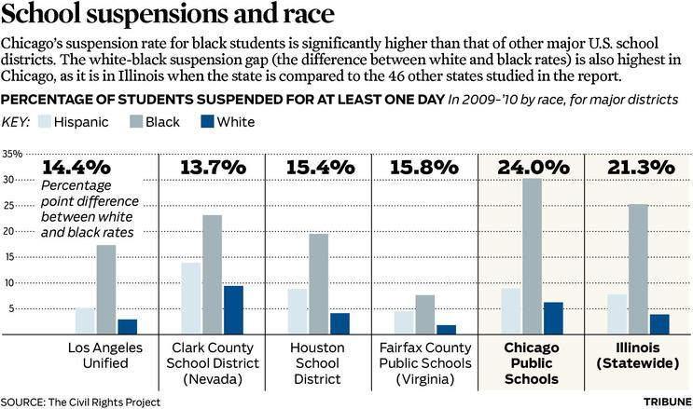
Safety: What is the role of SROs?
RESOLUTION #D068
Can school-based legal services stem the flow of pipelines?
Notes:
Does the application of criminal law in schools provide safety for children? Do school suspensions feed incarceration systems? Here the percentage of students suspended for at least one day during 2009, shown by race and school district. Chicago public schools suspension rate for black students is higher than the statewide percentage in Illinois. Pertaining to RESOLUTION #D067 FOR-PROFIT PRISONS AND #D068 SCOOL TO PRISON PIPELINE, can the establishment of school-based legal services stem the flow of imprisonment pipelines?

Slide 15
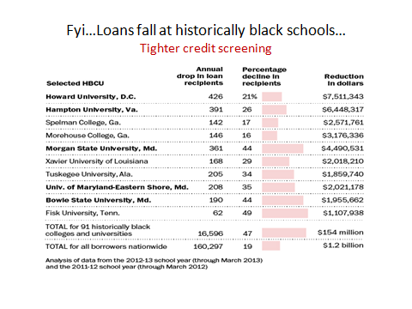
Notes:
And in the arena of higher education…
The Shanker Institute report by The Schott Foundation for Public Education September 23, 2015 titled The State of Teacher Diversity in American Education, brings attention to a major problem in education: while the percentage of students of color has been rising, the number of teachers of color has failed to keep up. For black educators, the situation is even worse. Over the past decade, the number of black educators has declined in all the cities surveyed in this study. In some places, like New Orleans and Washington, D.C., that drop has been huge. Greater diversity amongst teachers has been shown not only to help students of color, but also white students. Teachers of color tend to have higher expectations for students of color, serve as important role models, expose students to a larger variety of cultural and racial groups, and help to establish stronger communities of color as well. These contributions are valuable to student success, and show how essential teacher diversity can be. As students of color currently make up over half of students in public education (and that number is projected to rise), it becomes even more important.

Slide 16
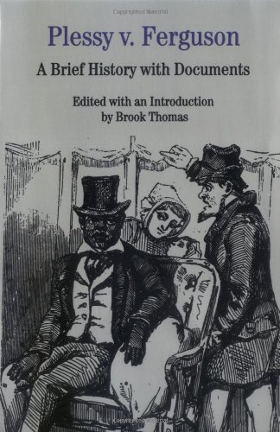
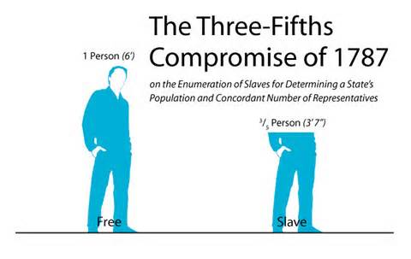
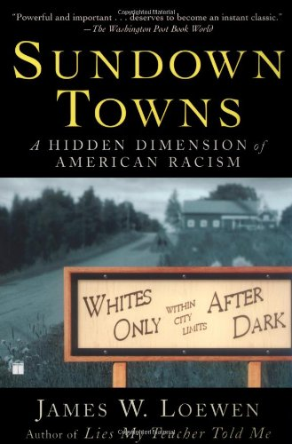
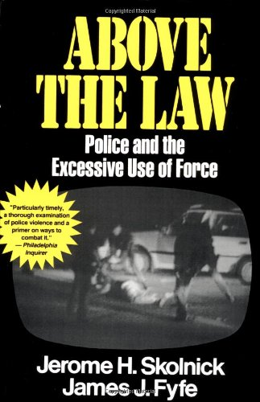
Starting the Conversation
Historical Race & Law Reform
DEFINITION OF PROBLEM
AND
SOLUTION PLANNING
What challenges do the people yet face?
What is the history underlying the challenges?
The Economics? The Sociology?
The Patterns and Practices?
Unjust law is no law at all. -Augustine of Hippo.
PLESSY v. FERGUSON
Brook Thomas, Editor. ©1996
James W. Loewen©2005
ISBN-13978-0-7432-9448-5
ISBN-13: 978-0029291535
Notes:
What is the history of justice as defined by the Constitution’s Comprise of 1787 that counted non-citizen slaves as 3/5th of a ‘whole’ person, a vote gerrymandering policy and practice that augmented the Southern plantation owners’ representation in the Congress? Today, what gerrymandering challenges do the people yet face? What are the economics of safety? The sociology? The Patterns and Practices? Who is considered to be ‘above the law’? And according to the featured stories of NBC, ABC, and CBS nightly newscasts, on whose bodies is “excessive force” usually applied?

Slide 17
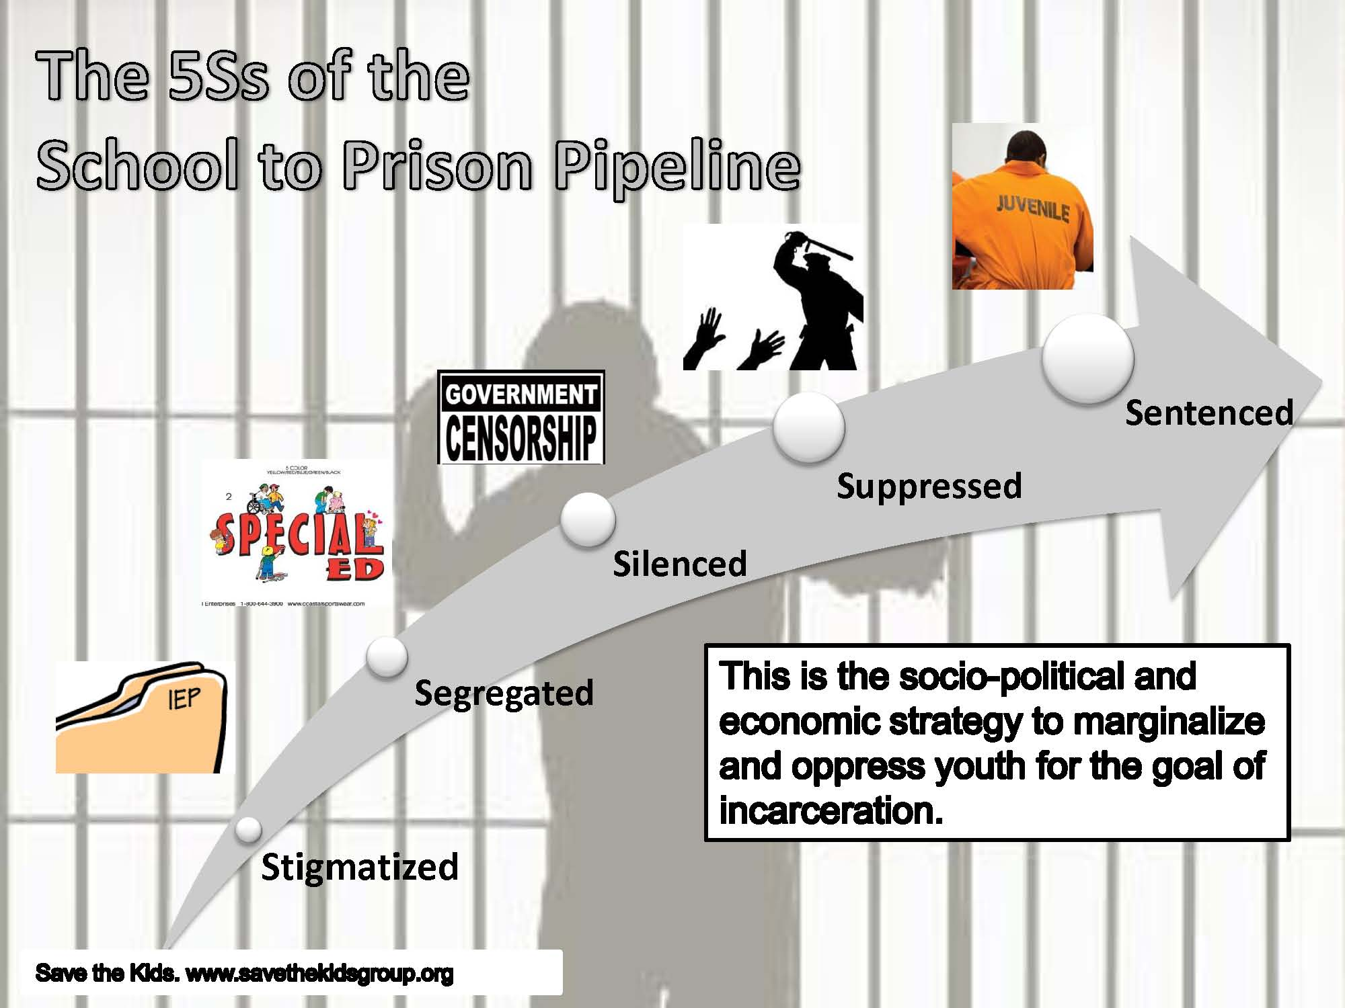
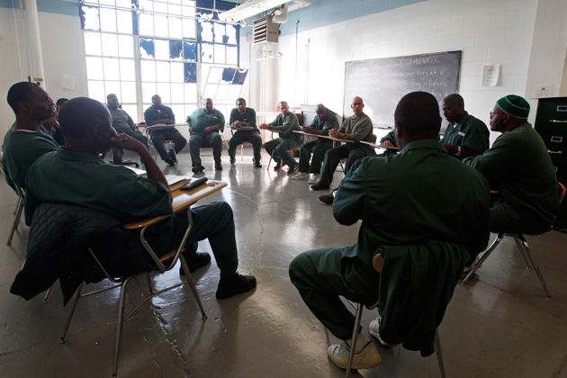
Re-Enslavement by Race and Practices of Law
2015 Re-Enslavement?
The Results
Inmates at the Clinton Correctional Facility Dannemora, New York
African-American Children
In 2015 ‘At-Risk’ Peril
Notes:
Who, then, who are the duly convicted? And relating to the School to Prison Pipeline, what is the re-enslavement processes and practices of law? If you look closely, the script indicates that there exists a socio-political and economic strategy to marginalize and oppress youth for the goal incarceration. Here depicted on this screen are the methodological practices that continually assault the psyches of young students of color via the five (5) S’s: The students are 1) Stigmatized by race and history. 2) Segregated from access to quality education. 3) Silenced by No Child Left Behind standardized testing of non-standardized teaching and learning. 4) Suppressed by prison-like in-school law enforcement criminalizing management practices that handcuff kindergartners for throwing a tantrum. 5) Sentenced. Students of color face harsher punishments in school than their white peers, leading to a higher number of youth of color incarcerated. Black and Hispanic students represent more than 70 percent of those involved in school-related arrests or referrals to law enforcement. Currently, African Americans make up two-fifths of incarcerated youth.
E. Ann Carson, Ph.D., Prisoners in 2014. BJS Statistician. September 17, 2015 NCJ 248955 Presents final counts of prisoners under the jurisdiction of state and federal correctional authorities on December 31, 2014, collected by the National Prisoner Statistics program. This report includes the number of prison admissions, releases, noncitizen inmates, and inmates age 17 or younger in the custody of state or federal prisons. It presents prison capacity for each state and the Federal Bureau of Prisons (BOP), examines the use of private prisons by state and the BOP from 1999 to 2014, and describes the offense and demographic characteristics of yearend federal and state prison populations. The report also includes year end counts for territorial and military correctional populations.

Slide 18
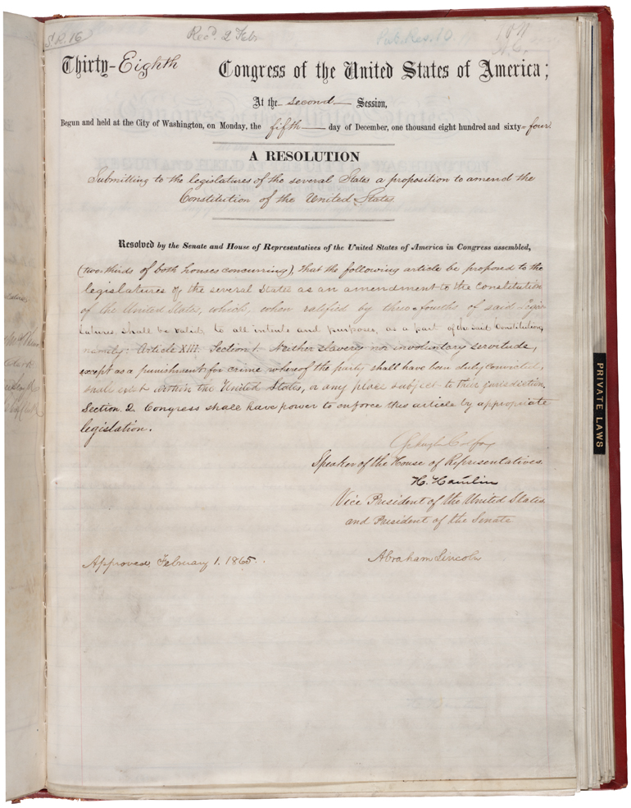
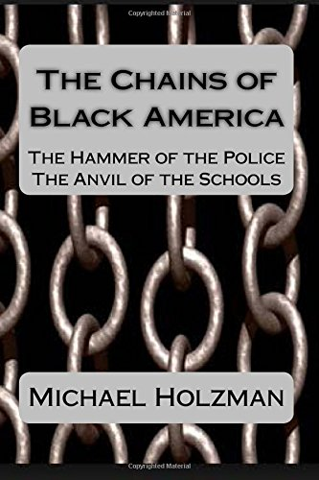
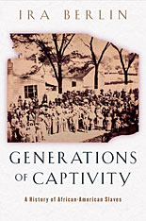
History &The Language of Law and Race
Backgrounds of Legal Race
2015
What challenges of Race and Law do the people yet face?
13th Amendment to the U.S. Constitution (1865)
and 2016 Mass Incarceration
©2014 by Michael Holzman ©2006 by Ira Berlin
"Neither slavery nor involuntary servitude, except as a punishment for crime whereof the party shall have been duly convicted…”
Notes:
What are the challenges of race and law do the people yet face? The first notification comes from a statement by author Herbert Aptheker: “Oppression exists because the dominant rulers of society find it highly profitable.” Remember this saying. And then re-read the wording of the 13th Amendment abolishing slavery that says: "Neither slavery nor involuntary servitude, except as a punishment for crime whereof the party shall have been duly convicted, shall exist within the United States…”

Slide 19
Authorization
The Thirteenth Amendment to the Constitution
Section 1.
Neither slavery nor involuntary servitude, except as a punishment for crime whereof the party shall have been duly convicted, shall exist within the United States, or any place subject to their jurisdiction.
Section 2.
Congress shall have power to enforce this article by appropriate legislation.
Ratified December 6, 1865.
Notes:
What I learned from my stint as an executive managing the State’s EEO and Minority Business Enterprise Programs was that all policy originates in the language the law: the Constitution of the United States; the Ohio Constitution; the Ohio Revised Codes and the Administrative codes. It is the from these governing sources that the authority to create the program implementation patterns and practices, and formulate the structures supportive of the enforcement power essential to accomplishment of the mission goals inherent to the language of the law. The phrase “except as punishment for crime whereof the party shall have been duly convicted…” has created 2016 Prison Industrial Complex. Google the Ohio State Constitution’s language…OR read the HANDOUT ON THE OHIO LEGISLATIVE BLACK CAUCUS.

Slide 20
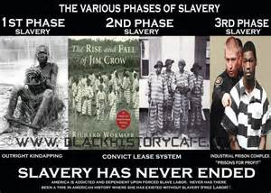
Ruffin v. Commonwealth, 62, Va (21 Gratt.) 790, 796 (1871)
Slavery beyond 1865
RESOLUTION #C019
Notes:
Slavery has never ended: some form of the ‘exception’ appearing in the Constitutions of 24 states.

Slide 21
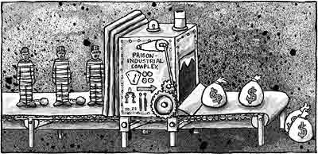
What is the dollar value of slavery 2016?
RESOLUTION #C019
Give a man a gun, he can rob a bank. Give a man a bank, he can rob the world.
Notes:
While the old saying notes that crime doesn't pay, that doesn't hold true for America's system of incarceration, which has seen spending more than triple since 1980. That means each U.S. resident is paying about $260 per year on corrections, up from $77 per person in 1980, thanks to the country's annual $80 billion price tag for incarceration, according to a report from The Hamilton Project think tank of The Brookings Institution.

Slide 22
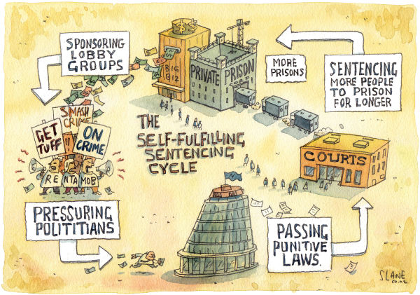
21st Century Prison Industrial Complex
RESOLUTION #C019
13th Amendment “except as punishment for crime whereof the party shall have been duly convicted…”
Notes:
The Prison Industrial Complex is indeed a self-fulfilling enterprise, fed by lobbyists pressuring politicians to pass more and more punitive laws for authorizing court convictions for growing lists of crime topics which sentence more people to prison for longer terms which engender the building of more prisons.

Slide 23
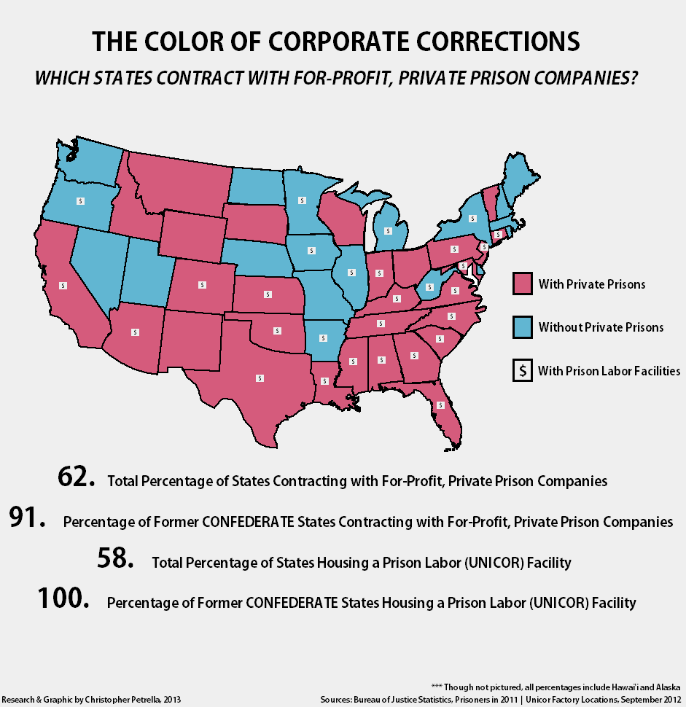
Is your state among them?
Notes:
The states in pink contract with Private Prison companies. Ohio is among them. Private prison companies are in the business to make money, policies that maintain or increase incarceration boost their revenues and their business model rests on incarceration. The more individuals locked up, the more shareholders profit. Increases in private prison earnings and stock prices invigorate America's incarceration boom via laws that criminalize longer lists of citizen conduct and require that those convicted serve longer sentences. Private prisons own contracts requiring a guaranteed occupancy rate for its prisons which in turn encourage tough law enforcement and longer-sentencing policies that deter reform. Google Corrections Corporation of America (CCA) of Ohio.

Slide 24
PROFITEERING: Prison Labor
RESOLUTIONS #D067 AND #A011
At least 37 states have legalized the contracting of prison labor by private corporations that mount their operations inside state prisons. The list of such companies contains the cream of U.S. corporate society:
IBM, Boeing, Motorola, Microsoft, AT&T, Wireless, Revlon, Dell, Compaq, Honeywell, Intel, Hewlett-Packard, Nortel, Lucent Technologies, 3Com, Northern Telecom, TWA, Nordstrom’s, Macy’s, Pierre Cardin, Target Stores, McDonald’s and many more.

Slide 25
PROFITEERING and PUNISHMENTS
Descendant from 13th Amendment to:
-New Jim Crow
-Lawful Racial Profiling
-Debtors’ Prison
-Plantation slavery
-Lynchings
-Factories; Sweat shops
-Corporation-owned prisons
-Prison stock investments
-Stop and Frisk
-School-to-Prison Pipelines
Notes:
Profiteering and punishment go hand in hand.

Slide 26
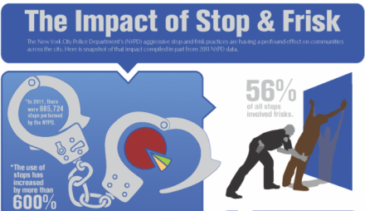
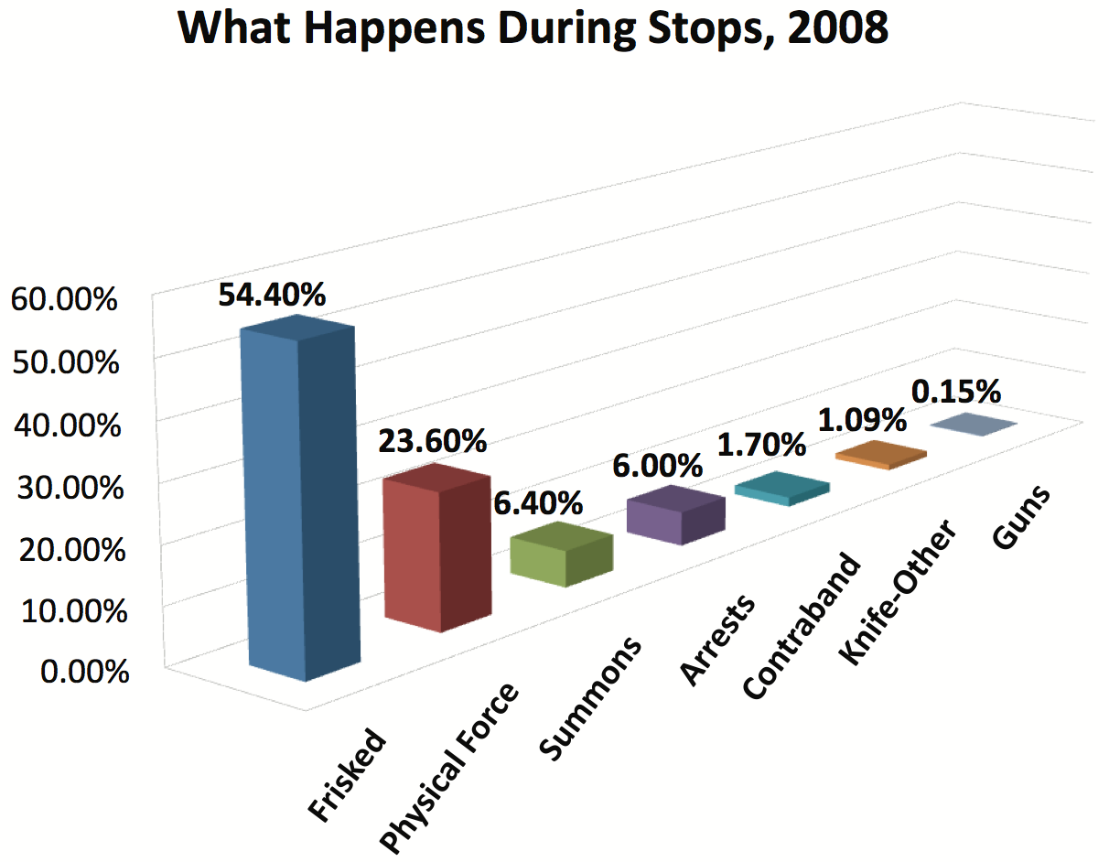

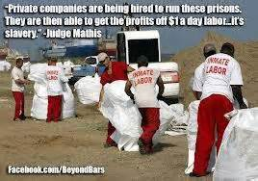
PROFITEERING
RESOLUTION #A011 REFORM AND ADVOCACY
Can enactment of Procedural Justice mitigate the egregious disparate impact effects of Law on the disparate treatment of citizens by Race? -mbm
Judicial ‘Cash for Kids’…
Notes:
Since Terry v. Ohio 392 U.S. 1 (1968), Supreme Court decision, stop-and-frisk racial profiling has become the tactic of choice used by police departments against African-Americans suspected of crime. Even though the Supreme Court recognized more than 45 years that a frisk is a “frightening, and ...humiliating experience,” the practice continues. Terry v. Ohio decision held that the Fourth Amendment prohibition on unreasonable searches and seizures is not violated when a police officer stops a suspect on the street and frisks that person without probable cause to, if the police officer has a reasonable suspicion or hunch that the person has committed, is committing, or is about to commit a crime and has a reasonable belief that the person "may be armed and presently dangerous."

Slide 27
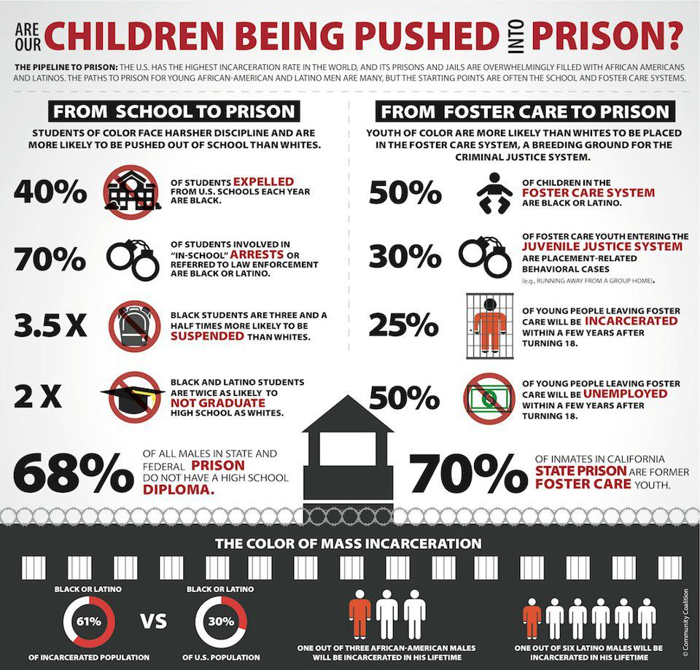
RESOLUTION #A011 REFORM AND ADVOCACY
Notes:
I have spent more than half of life’s career in education. These statistics are unconscionable. 68% of all males in state and federal prison do not have a high school education. 70% of inmates in California state prison are former foster care youth. 25% of young people leaving foster care will be incarcerated within a few years after turning 18. Is it true that foster care kids are turned out on the street at age 18. 70% of students involved in “in school” arrests or referred to law enforcement are Black or Latino. Black students are 3 and a half times more likely to be suspended than whites. Black and Latino students are twice as likely to not graduate from high school. 40% of students expelled are black. Shall we stand idly by?

Slide 28
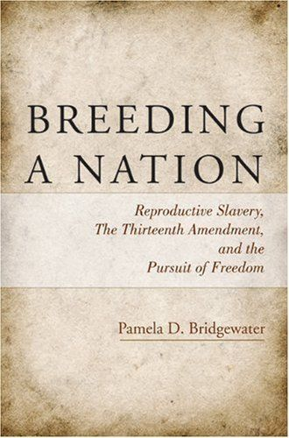
Ohio
RESOLUTION #C019
“And they raiz culuh like they raiz animal…” – Louisiana Creole
Article 1 - Ohio Constitution
§ 06 Slavery and involuntary servitude (1851)
There shall be no slavery in this state; nor involuntary servitude, unless for the punishment of crime.
Notes:
Northwest Territory language uses “otherwise”. SEE HANDOUT ON THE OHIO BLACK LEGISLATIVE CAUCUS PUSH TO EXPUNGE THE INVOLUNTARY SERVITUDE LANGUAGE from the Ohio Constitution.

Slide 29
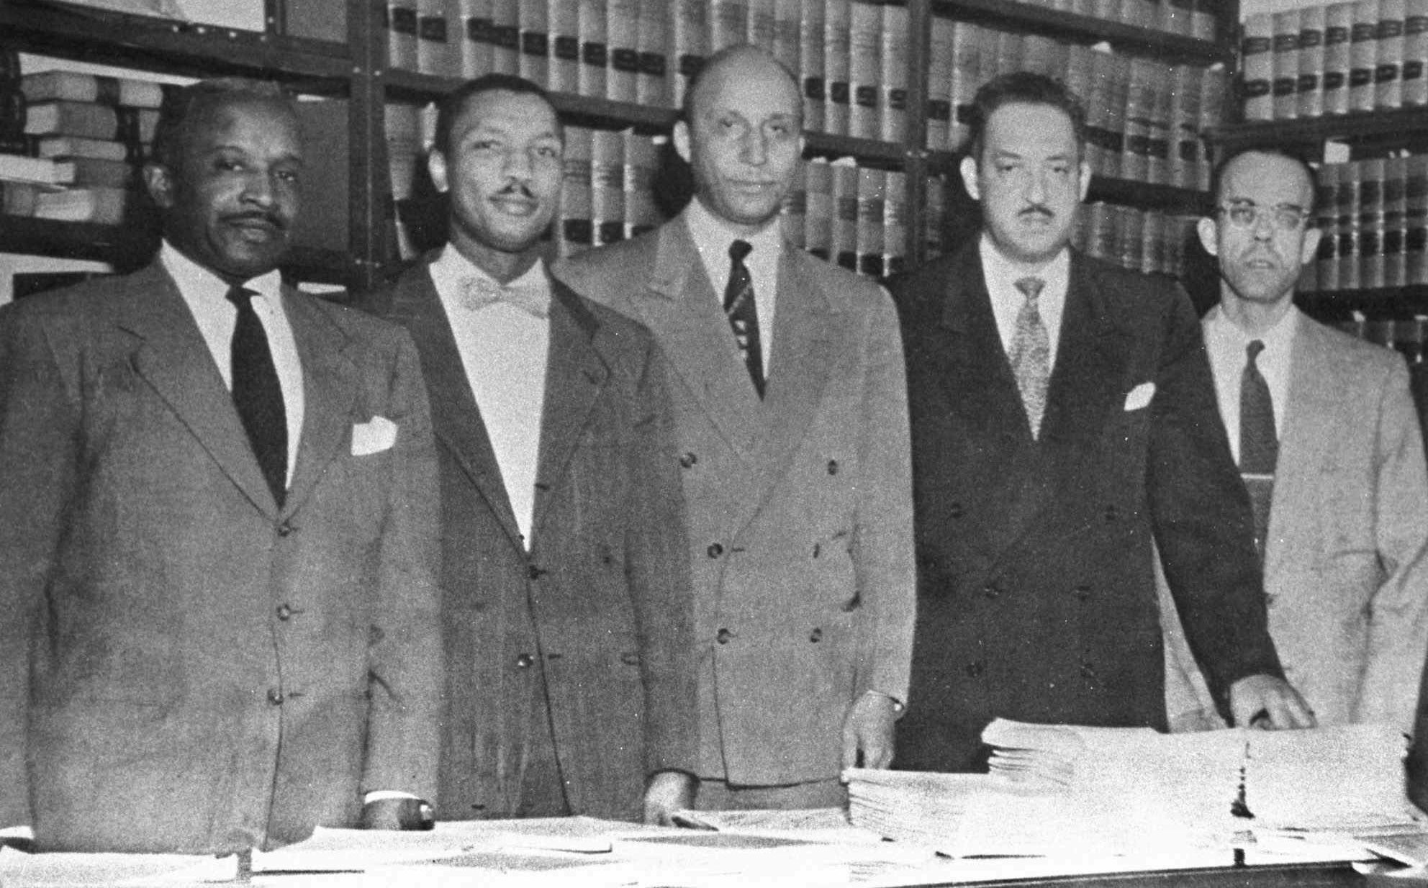
NAACP Changing History
1954 - 2016
Change Agents:
Builders of Capacity for Change
Lawyer Robert L. Carter and NAACP Legal Defense and Educational Fund Inc. attorneys that made up Thurgood Marshall's defense team in 1954. Left to right: Louis L. Redding; Robert L. Carter; Oliver W. Hill; Thurgood Marshall and Spotswood W. Robinson III.
NAACP Legal Defense Fund: Defend, Educate, Empower www.naacpldf.org
Notes:
The work of justice never ceases. It passes on to future generations. At the NAACP website I read the history of Charles Hamilton Houston and his protégé Thurgood Marshall, of how they developed a strategy and implemented a battle plan against “separate but equal” doctrine established in 1896 by the U.S. Supreme Court concerning Plessy v. Ferguson case. What in our generation will we do to increase safety for future generations? Shall we stand idly by?

Slide 30
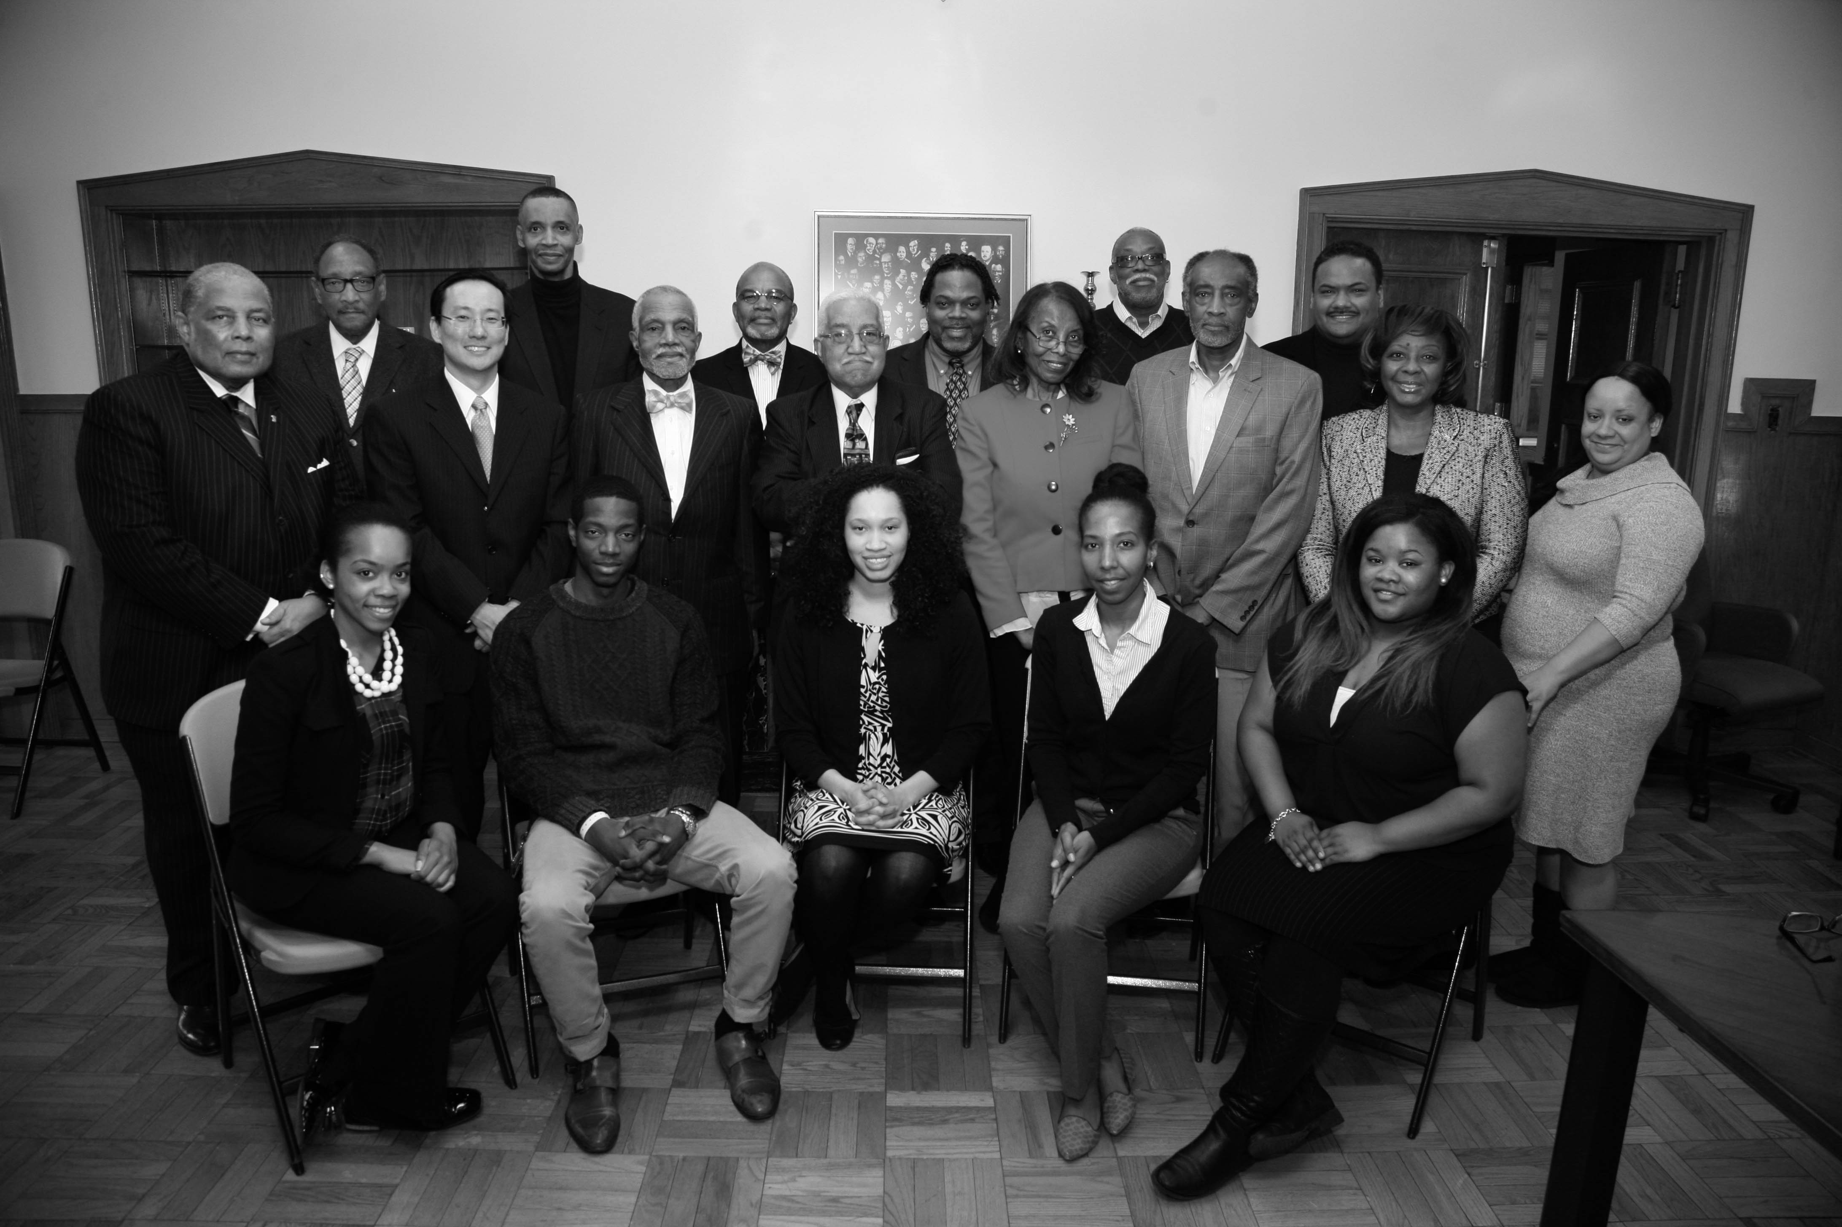
2016
Who will join the legal battle against 13th Amendment mass incarceration?
Change Agents:
Builders of Capacity for Change
The Organization on Procedural Justice (OPJ) commissioned by the Bishop of the Diocese of Southern Ohio, The Rt. Rev. Thomas E. Breidenthal.-March 28, 2015 Inaugural Meeting Howard University School of Law.
Notes:
The answer is no. Moral Voice will not stand idly by. The mission goal of The Organization on Procedural Justice (OPJ) is to amend the legal flaws of the 13th Amendment language authorizing prisoners as ‘slaves of the state’

Slide 31
New Language:
Removing the Loophole
“All persons are equal under the law, so NO person SHALL be held neither as a slave nor as an unpaid laborer within the country, its territories or possessions.”
-The Organization on Procedural Justice
Notes:
The ‘duly convicted’ requirement of the Thirteenth Amendment ‘except as punishment for crime’ of the U.S. Constitution is the fundamental authorization for the legal incarceration of the massive 2.2 million men, women, and children behind bars today.
Here reads the proposed new language.

Slide 32

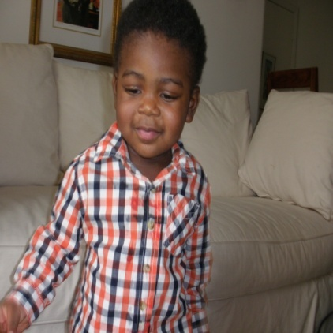






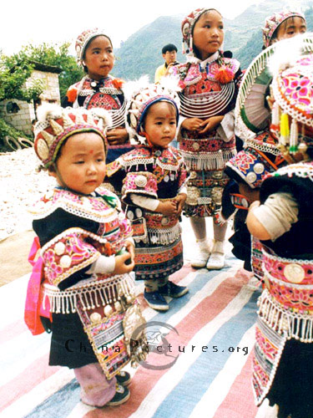
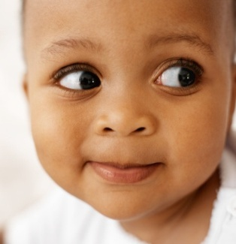




Safety?
Notes:
In summation, like race perception, color science considers the perception of color by the human eye and brain. Moreover, it considers the origin, the ancestry of color in materials. Color theory in art examines the physics of electromagnetic radiation in the visible range, commonly referred to simply as light. Therefore, the beauty of flowers in nature lies in the appreciation of the variances in colorations. Were it not for the ability and the willingness to see color, much of the beauty of the world would be lost to human souls.
I recommend and am deeply thankful that we live in a world where light and color exist in broad spectra, where one can look for and accurately perceive the beauty of human faces among the flowers. Justice for protecting the lives of future generations lies in the willingness to see.
My name is Merelyn Bates-Mims. Thank you for inviting me. I am grateful.
Redefining Justice: The Thirteenth Amendment & Carceral Policy has been our topic of discussion today.

